Slide 1
Retailer Recommendation Using Facial Recognition
Presented by :
Saurabh Dhawale
Sameer Gode
Devendra Hande
Under guidance of:
Prof. Kanchan Doke

Slide 2
Overview
Content | Slide number
Abstract | 3
Introduction | 4
Literature Survey | 5
Problem Statement | 7
Work Flow | 8
Architecture | 10
Output | 13
Conclusion | 17
References | 18

Slide 3
Abstract
The goal of this project is to provide user with a very personalized selection of shops to buy from by using face recognition. Crucially, face recognition technology enables offline stores to do what their online counterparts have been doing for years – identify shoppers, link them to past purchases and generate personalized product recommendations based on the data. When a retailer knows its customers, it can serve them more effectively. Facial recognition has the potential to give traditional stores a wider view, showing who’s buying what and when. Access to this data allows shops to identify problems and grasp opportunities, providing superior customer service that will keep shoppers happy and engaged. Facial recognition will consider certain aspects of a customer such as gender and age to recommend shops which will best provide what the customer may want.

Slide 4
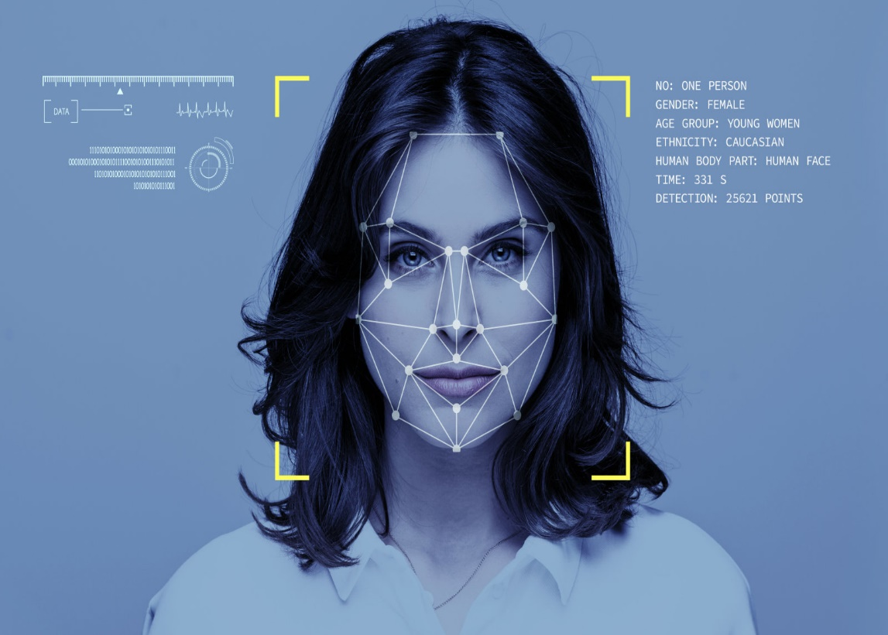

Introduction
Understanding your customer has become an essential aspect for retailer. Knowing your customer gives you an edge in marketing strategy.

Slide 5
Literature Survey
Existing System-
The Phoenix Market City Mall currently has an implemented system which directs their customers to a particular floor for a specific brand.
Interaction from customer’s side is required on the touch screen for the system to function.
This system , however, does not understands or make a personalized experience for the customer.
Hence, it makes itself only a simple guide for the mall.

Slide 6
Literature Survey Continued
Paper Name | Publisher | Approach | Disadvantages
Age Group Estimation and Gender Recognition Using Face Features[1] | The International Journal of Engineering and Science | Support vector machine (SVM) | Lacks accuracy compared to deep learning model.
An Image Mining System for Gender Classification & Age Prediction Based on Facial Features[2] | e ISSN: 2278 Volume 10, Issue 6 (May. - Jun. 2013) | PCA ,Nonlinear SVM,KNN | Non linear SVMs are computationally heavy.
Partial Face Recognition: Alignment-Free Approach[3] | IEEE transactions on pattern analysis | PCA + LDA & LBP Canny edge detector . | PCA feature removal is critical.

Slide 7
Problem statement
Our system aims to solve the problem of non existence of proper recommendation system for offline retailers.
The Phoenix Market City Mall currently has an implemented system which directs their customers to a particular floor for a specific brand. Interaction from customer’s side is required on the touch screen for the system to function.
Our model aims to give better accuracy as compared to previous Facial recognition Systems.

Slide 8
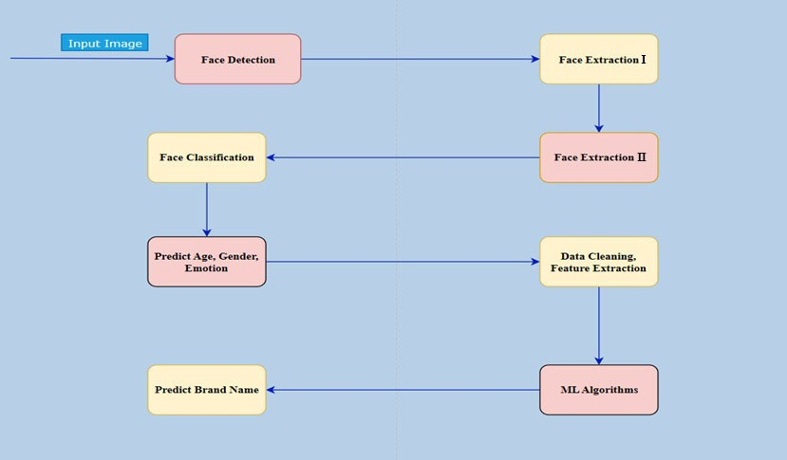
Work Flow

Slide 9
Work Flow Continued
1. Dataset Cleaning : We will impute the missing values in dataset with the mean values for continuous variables, and median for categorical variables.
2. Feature Extraction : By using PCA or feature importance we will select the best features that contribute the most.
3. Face Recognition : Employing methods such as Adaboost, Random Forest, XGBoost, SVM and Artificial Neural Network we will try to classify the images into Male or Female.
4. Predicting : Using Features such as Age and Gender we can predict the mall outlets.
5. Output : The Output Screen will suggest users with the Outlets that they should visit.
We will create a prototype face recognition system based on pre-trained CNN models that is able predict their gender, age and emotions in an image or video.
Using Facial Recognition we will determine age and gender and make their columns in the dataset.
The next and final phase of the learning algorithm will be to predict the target variable “Brand” using algorithms like Random Forest and Decision Tree
Thus brand names will be recommended for the customer which are the result of customer’s facial features.

Slide 10
Architecture
Stages | Face Detection | Face Feature Extraction | Face Classification | Brand Classification
ML Models | - | - | CNN Classifier | Random Forest Classifier
Libraries | OpenCV | OpenCV | Keras TensorFlow | Scikit Learn
Language | Python | Python | Python | Python

Slide 11
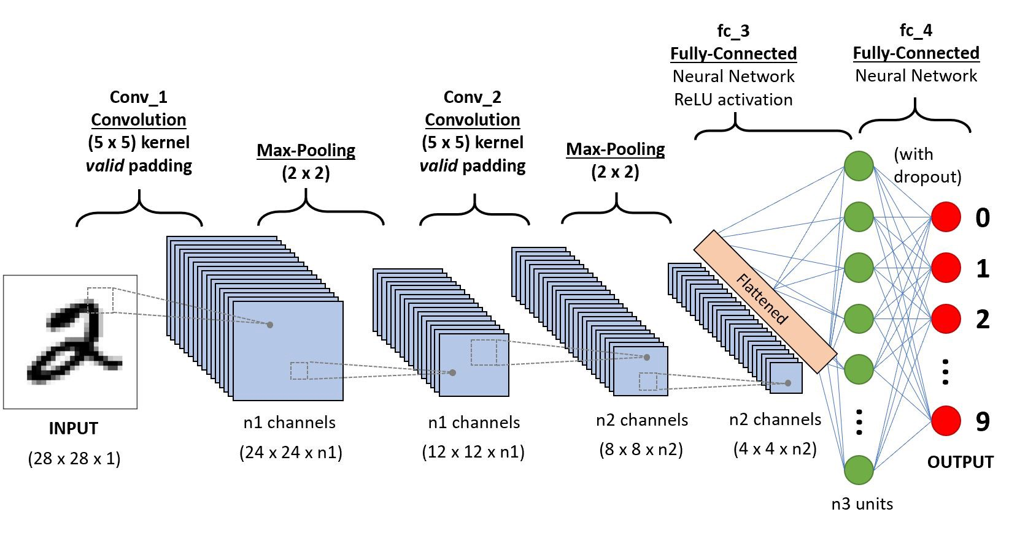
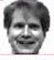
Convolution Neural Network
A Convolutional Neural Network (ConvNet/CNN) is a Deep Learning algorithm which can take in an input image, assign importance (learnable weights and biases) to various aspects/objects in the image and be able to differentiate one from the other. The pre-processing required in a ConvNet is much lower as compared to other classification algorithms. While in primitive methods filters are hand-engineered, with enough training, ConvNets have the ability to learn these filters/characteristics.
Input : Images/Videos
Output : Age , Gender , Emotion .

Slide 12
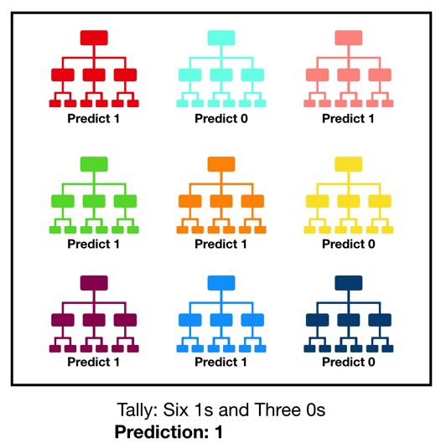
Random Forest
Decision trees leave you with a difficult decision. A deep tree with lots of leaves will over fit because each prediction is coming from historical data from only the few houses at its leaf. But a shallow tree with few leaves will perform poorly because it fails to capture as many distinctions in the raw data.
The random forest uses many trees, and it makes a prediction by averaging the predictions of each component tree for regression problems.
Input : Age , Gender (This are O/P of Facial Recognition)
Output : Brand Name .

Slide 13
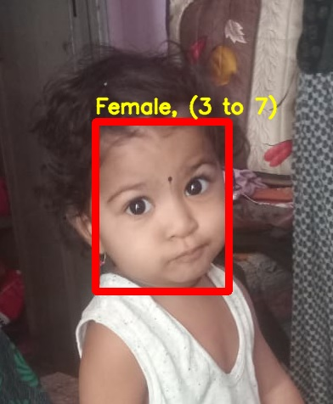
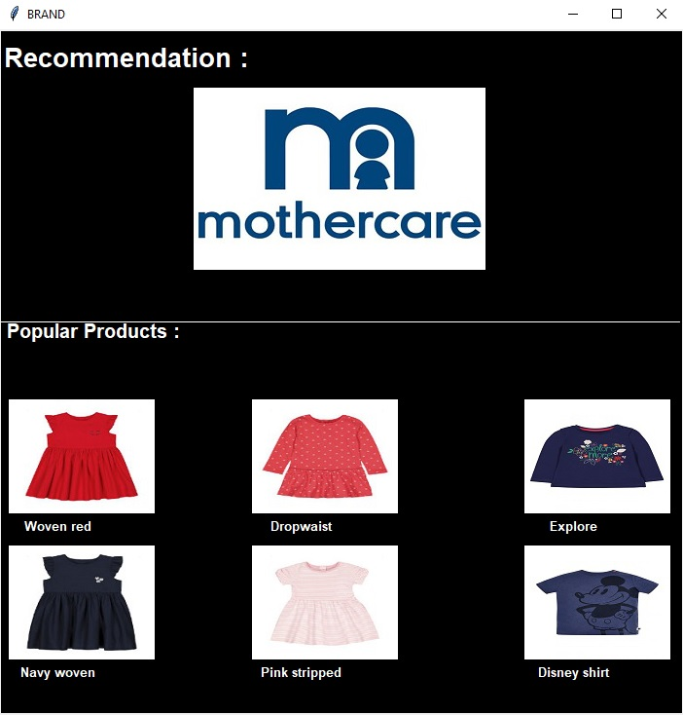
Output

Slide 14
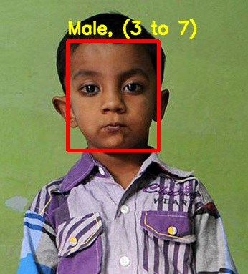
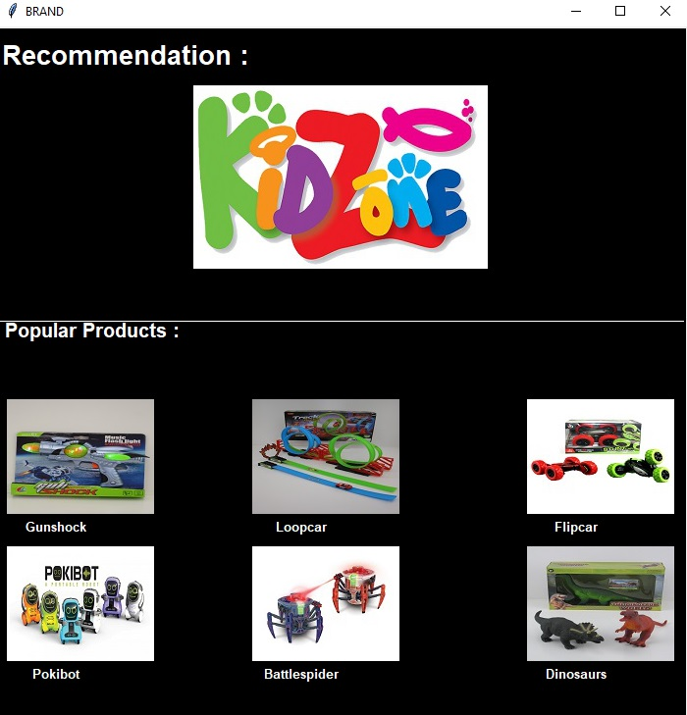
Output Continued

Slide 15
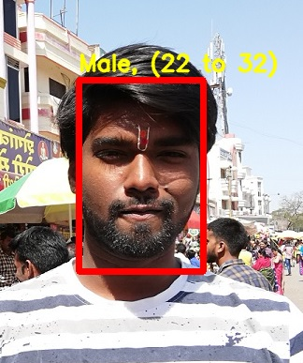
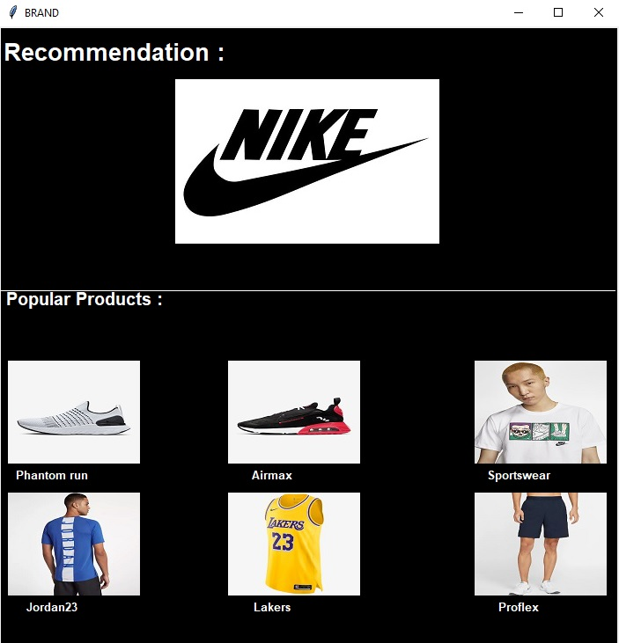
Output Continued

Slide 16
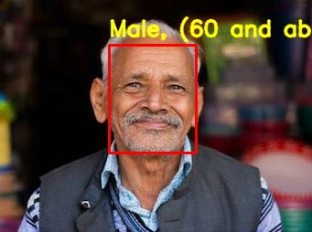

Output Continued

Slide 17
Conclusion
Thus we conclude that by using our model, the sale and the user experience can be significantly improved.
The offline retailers can go toe to toe with the online retailers and can have major say in the market share.

Slide 18
References
[1]Age Group Estimation and Gender Recognition Using Face Feature in The International Journal of Engineering and Science (IJES) || Volume || 7 || Issue || 7 Ver. I|| Pages || PP01-07 || 2018 || ISSN (e): 2319 – 1813 ISSN (p): 23-19 – 1805 Prajakta A. Mélange , Dr. G. S. Sable.
[2]An Image Mining System for Gender Classification & Age Prediction Based on Facial Features in e-ISSN: 2278 Volume 10, Issue 6 (May. - Jun. 2013) Ms.Dhanashri Shirkey , Prof.Dr.S.R. Gupta .
[3]Partial Face Recognition: Alignment-Free Approach in IEEE transactions on pattern analysis Shengcai Liao, Anil K. Jain, Fellow, IEEE and Stan Z. Li .

